Slide 1
Flying Drones with Gestures
How to fly drones directly using gestures filmed by a camera

Slide 2







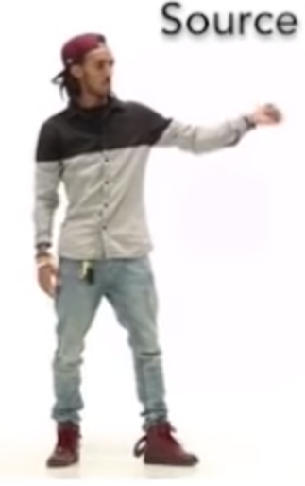







Pose Detection: How it Works
PoseNet
Gesture Detection
Steering Module
Video
Wireframe
Movements
Accounting
Accounting System
Azure SQL
Pricing Parameters
Reference Data
Contract Data
Payment
eBanking
Container Provider System
Insurer Contract Management System
Delivery of transport data:
Client
Start / end position
Temperature data
Storage of contract data for risk and capital management purposes
Storage of claims data for claims settlement
Transport Data
Contract Data
Document Storage
Legend:
Manual Interface
REST API
System
Database
Report
Component
Functionality
Flow
Logic Apps
Azure Functions

Slide 3

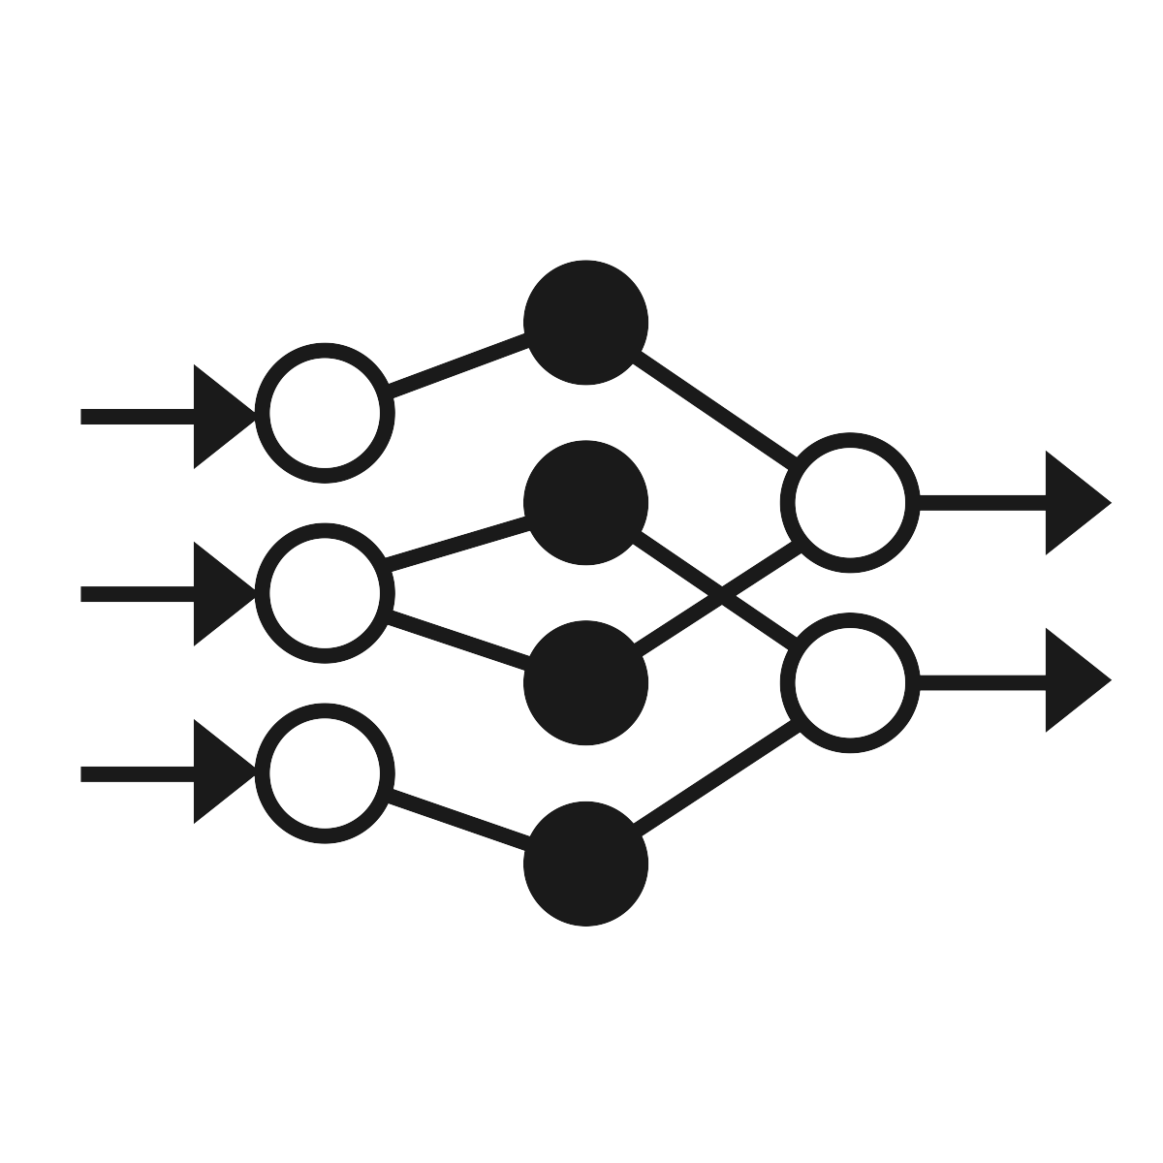

Pose Detection: How it Works
PoseNet
Gesture Detection
Steering Module
Client (Browser)
Video
Server
Server
Steering Module
Wireframe
Movements
Accounting
Accounting System
Azure SQL
Pricing Parameters
Reference Data
Contract Data
Payment
eBanking
Container Provider System
Insurer Contract Management System
Delivery of transport data:
Client
Start / end position
Temperature data
Storage of contract data for risk and capital management purposes
Storage of claims data for claims settlement
Transport Data
Contract Data
Document Storage
Legend:
Manual Interface
REST API
System
Database
Report
Component
Functionality
Flow
Logic Apps
Azure Functions

Slide 4

Project Planning
Stage 1
PoseNet
Posture Calculation with Deltas
Movement Display
Video
Wireframe
Movements
Stage 2
PoseNet
Posture Detection with Keras Model
Movement Display
Video
Wireframe
Movements
Stage 3
PoseNet
Gesture Detection with Keras Model
Steering Module
Video
Wireframe
Movements
Stage 4
PoseNet
Gesture Detection with Keras Model
Steering Module
Video
Wireframe
Movements
New functionality for a stage
Accounting
Accounting System
Azure SQL
Pricing Parameters
Reference Data
Contract Data
Payment
eBanking
Container Provider System
Insurer Contract Management System
Delivery of transport data:
Client
Start / end position
Temperature data
Storage of contract data for risk and capital management purposes
Storage of claims data for claims settlement
Transport Data
Contract Data
Document Storage
Legend:
Manual Interface
REST API
System
Database
Report
Component
Functionality
Flow
Logic Apps
Azure Functions

Slide 5
Postures
STOP
takeoff | 0
move forward | 1
flip | 2
left | 3
right | 4
land | 5

Slide 6
Gestures
take off
id=0
left
id=3
LAND
land
id=1
right
id=4
move
id=2
flip
id=5

Slide 7
Postures vs. Gestures
Posture
A posture is a single static position, which we call “frame” (essentially the x/y coordinates at a given point in time).
Modelling this is straight-forward. We train the model with individual frames which we provide with labels. Once trained, the model predicts a label from a given frame. Labels are movements, e.g. take-off, right or land.
Model
right
id=4
Gesture
A gesture is a set of consecutive positions, e.g. the hand positions while doing a circle. The frames containing these consecutive positions are produced as a stream over time. Our data therefore needs some sort of “memory” as the model needs to capture the whole set of consecutive positions.
We model this “memory” by grouping the last n frames in a
“sequence”, i. e. the set of the consecutive positions at a given point in time. These sequences are the input into the gesture model. The sequence length thus determines how long the model can remember the previous position.
Let’s look at an example:
For illustration, we colour frames that are relevant (i.e. contain the gesture) in grey
At t=0 the memory contains the full “flip” movement
At t=1 the memory starts fading as a new frame with an unrelated posture comes in
At t=2 and t=3 we have less and less of the original “flip” movement in the memory.
In the next slide we describe how we go about labelling sequences and introduce a notion of tolerance.
is represented as a frame set
Model
flip
id=5
t
memory
time
t
0
1
2
3

Slide 8
Gestures Intricacies | Labelling Training Data
…
For our model one data point is a sequence ( ) of 20 consecutive frames which together constitute a gesture. We show relevant frames (i.e. frames which are part of the gesture) as and non-relevant frames as . When we label a frame set as a gesture we show this with a in the sketches.
Our model should detect also sequences not containing all the relevant frames but only the main part. We therefore also label incomplete sequences. We assume a tolerance range of 10 frames around the last relevant frame of a gesture. Sequences at the beginning or end of the tolerance range thus contain fewer relevant frames than sequences in the middle of the range – see the first sketch below.
set contains 15 relevant frames
set contains 18 relevant frames
set contains 20 relevant frames
set contains 17 relevant frames
t
…
…
…
…
…
…
…
…
…
…
…
…
…
…
…
…
…
…
…
…
memory
time
…
t
0
1
2
3
12
13
14
15
16
17
18
19
20
21
22
23
24
25
26
lower tolerance = -5 frames
upper tolerance = +5 frames

Slide 9
Gestures Intricacies | Handling Errors
We humans are imperfect beings and rarely manage to make gestures fitting exactly into 20 frames. Our model therefore accounts for longer and shorter gestures. We accept an error of up to +/- 5 frames (half the tolerance range). This means gestures can be as short as 15 or as long as 25 frames (but the sequence length is still limited to 20 frames). All sequences within the error interval (see below) thus contain the same number of relevant frames. This works for both longer and shorter gestures – see sketches below.
set contains 15 relevant frames
set contains 17 relevant frames
set contains 14 relevant frames
Gesture too short (17 frames)
…
…
…
…
…
…
…
…
…
…
…
…
…
…
…
…
…
…
…
…
…
t
0
5
…
15
16
17
18
19
20
21
22
23
24
25
lower tolerance = -3.5 frames
error = -3 frames
upper tolerance = +3.5 frames
set contains 17 relevant frames
set contains 20 relevant frames
set contains 18 relevant frames
Gesture too long (22 frames)
…
…
…
…
…
…
…
…
…
…
…
…
…
…
…
…
…
…
…
…
…
…
t
0
5
15
16
17
18
19
20
21
22
23
24
25
lower tolerance = -4 frames
error = +2 frames
upper tolerance = +4 frames

